Slide 1

PriviChat: A Secure P2P Communication App
Project Number: 15004114
Team Members: Shai Michaeli
Lecturer: Amir Kirsh
Workshop: Network Applications

Slide 2
The Privacy Problem in Modern Chat Apps
End-to-End Encryption Issues: Many chat apps store backups on cloud servers that are often not encrypted, leaving them vulnerable.
Metadata Collection: Even if messages are encrypted, metadata can reveal communication patterns.
Data Selling: User data is often sold to third parties, compromising privacy.
Target Audience: Privacy-conscious users, activists, journalists, and professionals handling sensitive information.

Slide 3
PriviChat: The Secure Alternative
Peer-to-Peer (P2P) Communication: PriviChat uses a decentralized architecture for direct communication.
End-to-End Encryption: Every message, file, and call is encrypted from sender to recipient.
Local Data Storage: All data is stored locally on the user’s device.
Transparency and Control: Users have full control over their data with no hidden backdoors.

Slide 4
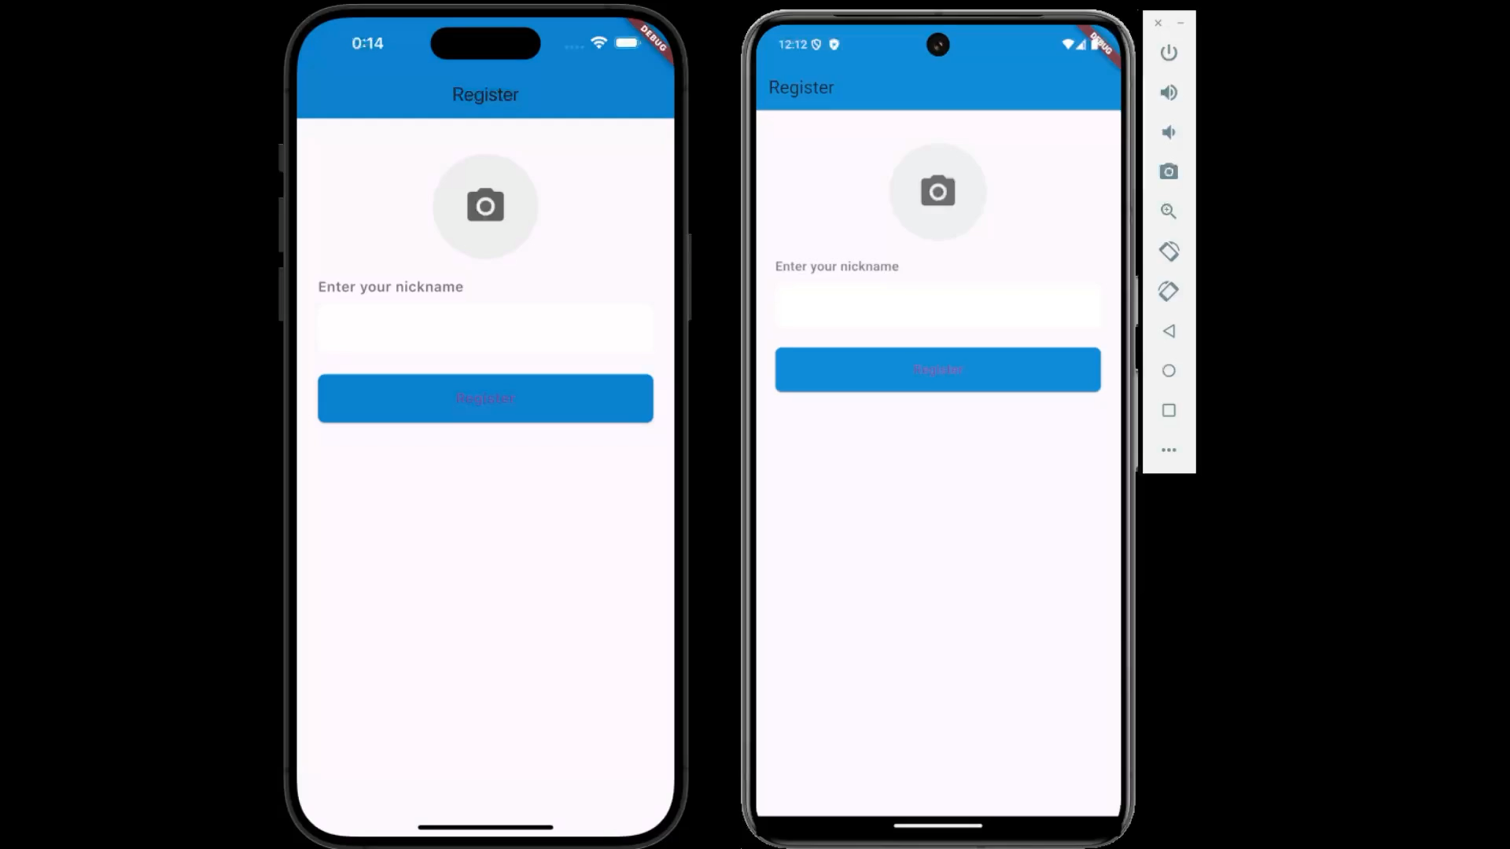
PriviChat Demo Video

Slide 5
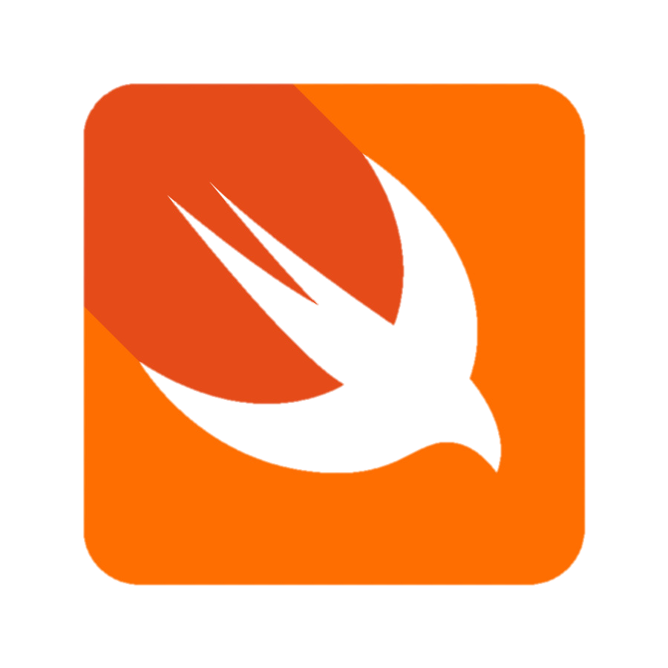




Technologies and Data Flow in PriviChat
Technologies Used:
Flutter for cross-platform development.
Firebase Firestore for P2P discovery.
WebRTC for secure P2P communication.
Kotlin and Swift for OS-specific adjustments.

Slide 6
Technologies and Data Flow in PriviChat
Data Flow:
Client ‘A’ initiates communication and discovers Client ‘B’ using Firebase Firestore.
WebRTC initiates a handshake for a direct P2P connection.
Secure data transmission occurs directly between devices.
WebRTC Handshake:
ICE Candidates are used to find the best path for P2P connection.
DTLS-SRTP Encryption secures the connection.
Once the handshake is complete, secure P2P communication is established.

Slide 7
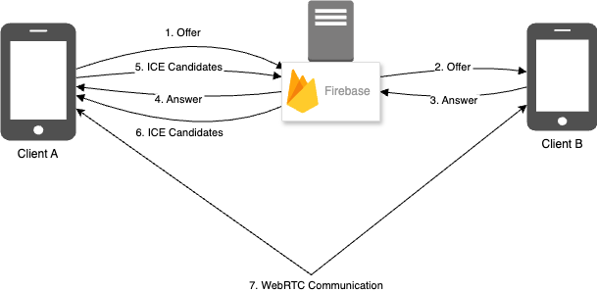
Technologies and Data Flow in PriviChat

Slide 8
Alternatives to PriviChat’s Approach
Signal: Secure messaging app using end-to-end encryption but relies on centralized servers.
Briar: P2P messaging app using Bluetooth or Wi-Fi for communication.
Server-Based Encryption Models: Apps like WhatsApp offer strong encryption but involve cloud backups and metadata collection.
Drawbacks Compared to PriviChat: Centralized servers, metadata collection, reliance on cloud backups, and less user control.

Slide 9
PriviChat: Secure Communication for the Modern Age
Summary:
PriviChat addresses critical privacy issues using a decentralized P2P approach, end-to-end encryption, and local data storage.
Impact:
PriviChat’s architecture ensures users have complete control over their data and communications.

